Slide 1
CO227 PROJECT MID EVALUATION
FINITE ELEMENT BASED
STRUCTURAL ANALYSIS

Slide 2
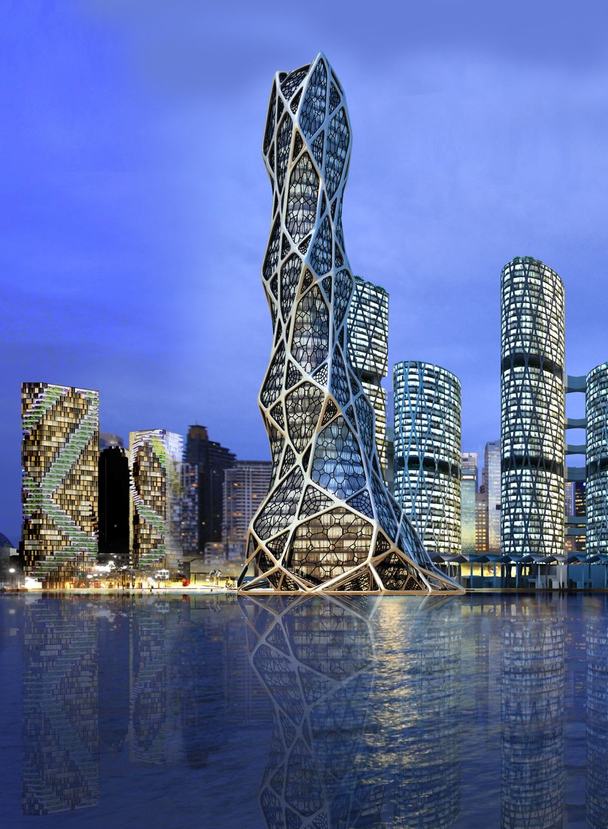
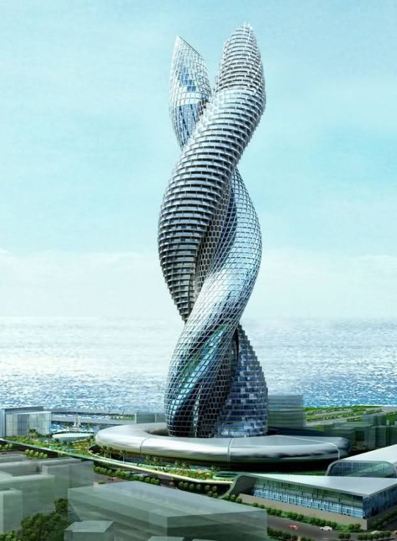
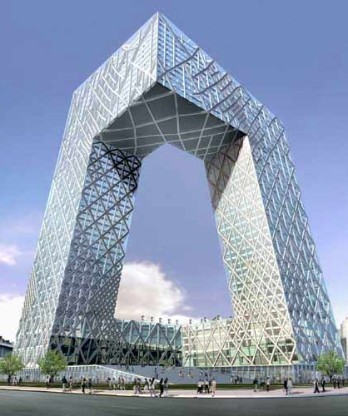
WHAT YOU SEE
Bionic tower, Abu Dhabi
Cobra tower, Kuwait
CCTV Headquarters, China

Slide 3
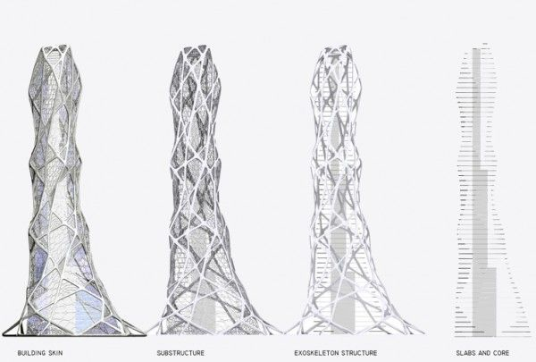
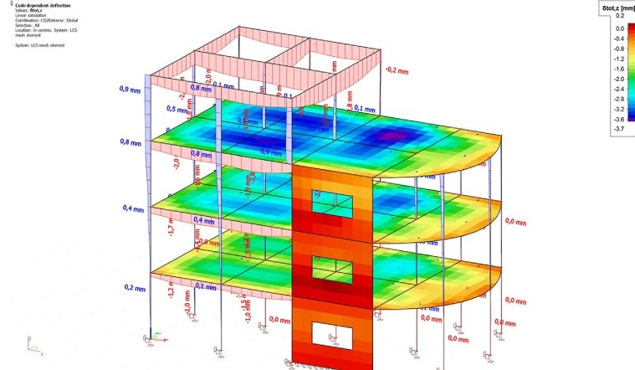
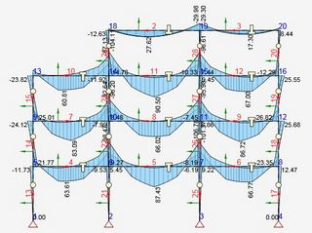
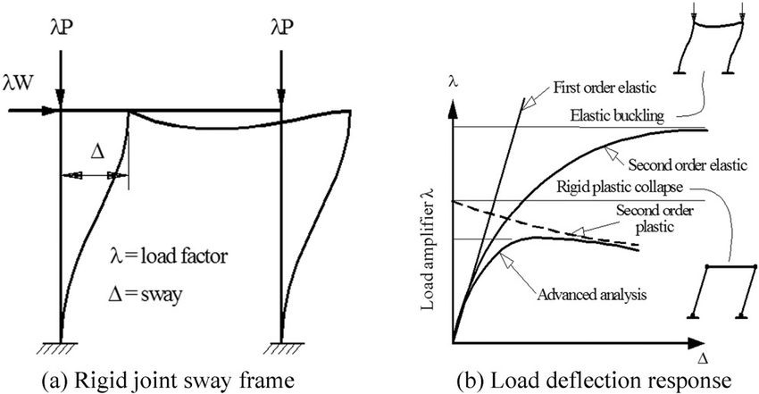
WHAT STRUCTURAL ENGINEERS SEE

Slide 4
HOW COMPLEX ?

Slide 5
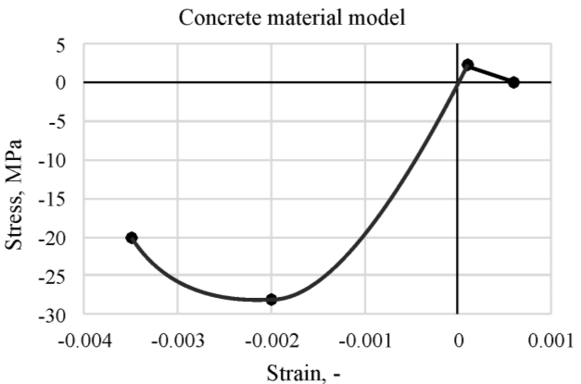
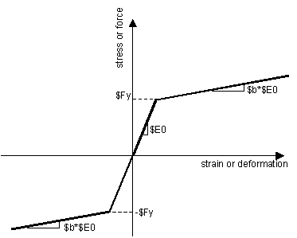
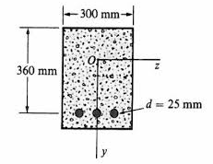
Steel material model
Reinforced concrete
Cross section

Slide 6


LINEAR
NON-LINEAR
F = K e
K is Constant
Small loading conditions
K Varies
Extreme loading conditions
Widely used software : SAP 2000
Widely used software : Opensees
Developed in Berkeley,
University of California

Slide 7
Interaction of
Axial force - Bending moment

Slide 8
Using a novel formulation developed by
the Department of Civil Engineering
Interaction of
Axial force - Bending moment - Shear force

Slide 9
A SIMPLE OVERVIEW
OF THE SOFTWARE

Slide 10
Nodes
Beams
Columns
Simple 3 story building using reinforced concrete frames

Slide 11
Degrees of freedom
z
m
x
y
Structure Level
Element Level

Slide 12
Concrete
Fibers
Steel
Fibers
Element
Section Level
Fiber Level

Slide 13
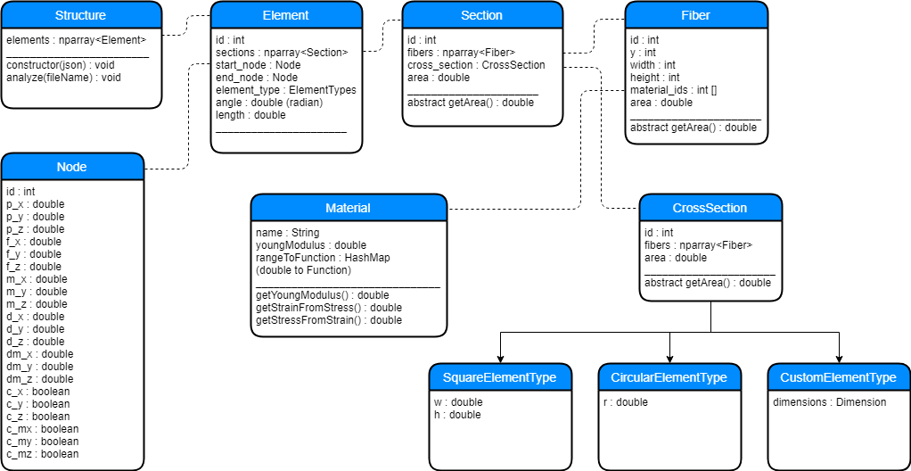
CLASS DIAGRAM

Slide 14
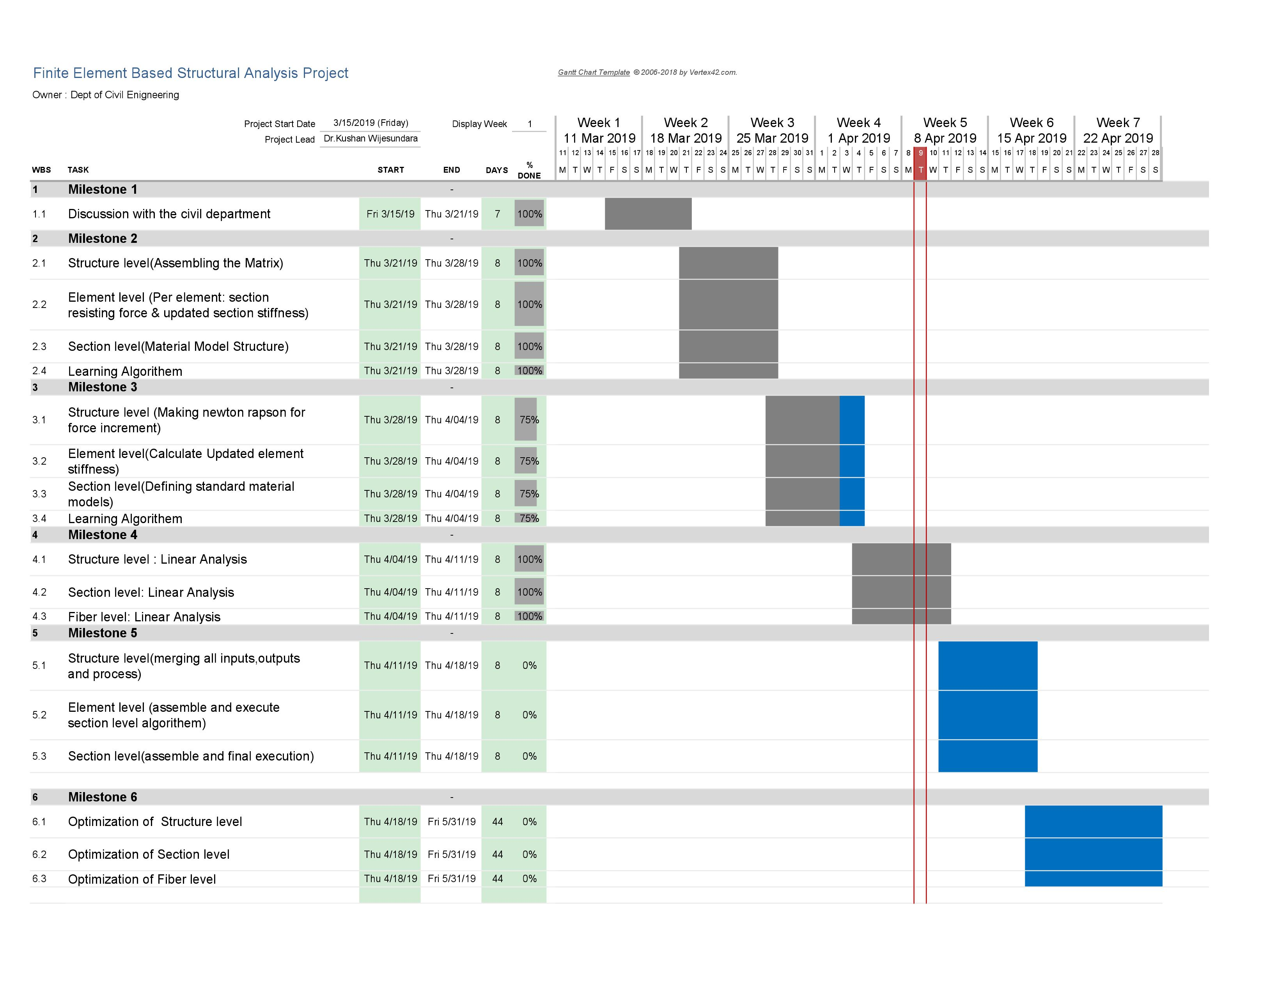
PROJECT PLAN AND PROGRESS

Slide 15
PROJECT PLAN AND PROGRESS

Slide 16
DEMONSTRATION

Slide 17
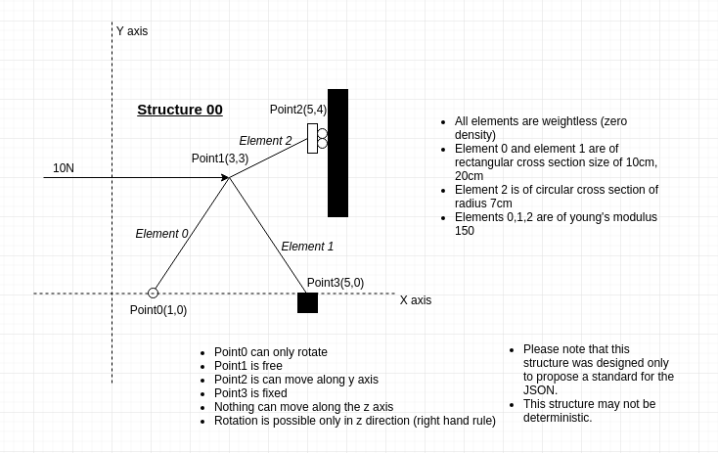
STRUCTURE WE ARE GOING TO ANALYZE

Slide 18
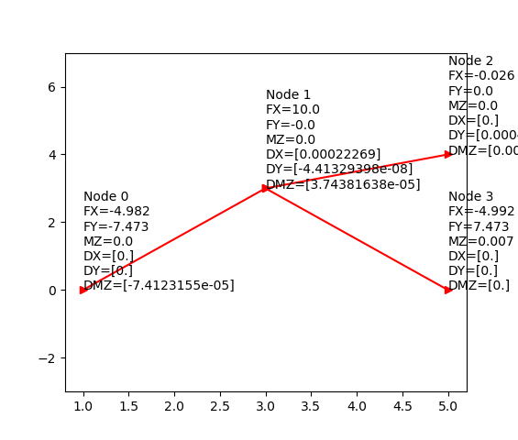
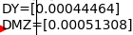
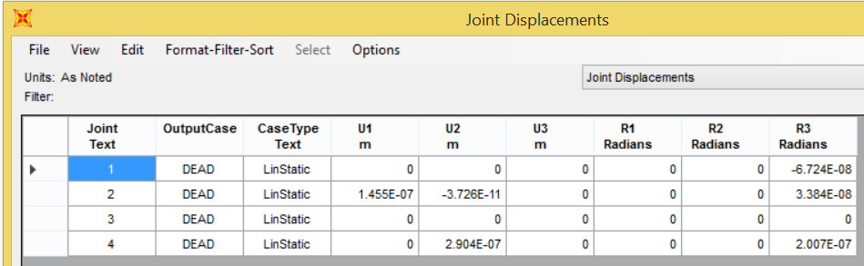
RESULTS COMPARISON
Displacements
SAP2000
Our results

Slide 19
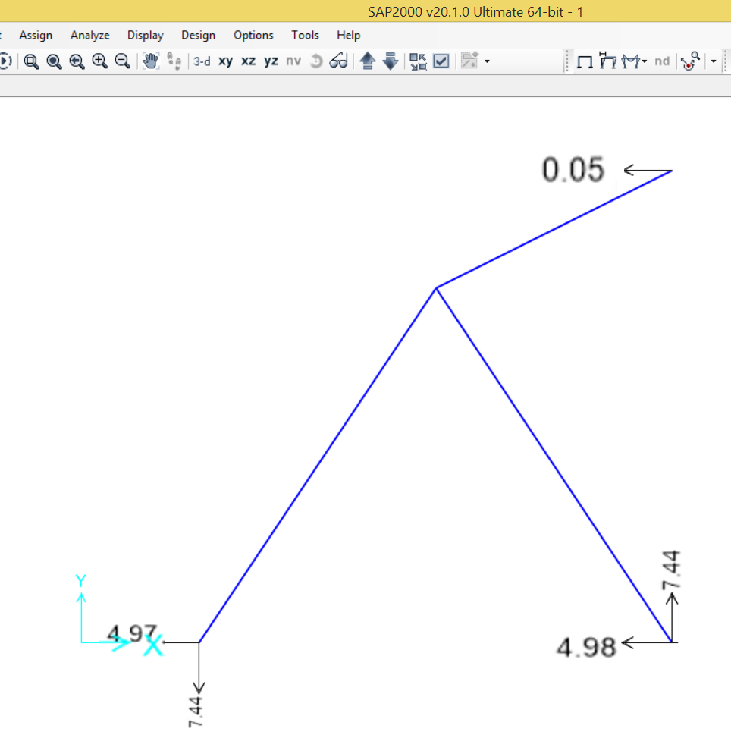
RESULTS COMPARISON
Forces
SAP2000
Our results

Slide 20
NEXT STEPS
Improvements
- Extending for 3D structures
Optimizations
- Parallelizing calculations
- GPU processing

Slide 21
Q & A

